Slide 1

Regular Expressions
CSCI 265 Lecture 4
By Ariel Avshalom

Slide 2
REGEX? OH NOOOOesS
Yes, people hate on regular expressions and they have good reason to
They’re messy
Hard to read
Generally very poorly documented in a codebase

Slide 3
So why are we studying them?
Because they do their job really well
And after this unit, hopefully they’ll appear less scary
And because all of those NFA’s and DFA’s that we’ve been doing are strongly related to REGEX

Slide 4

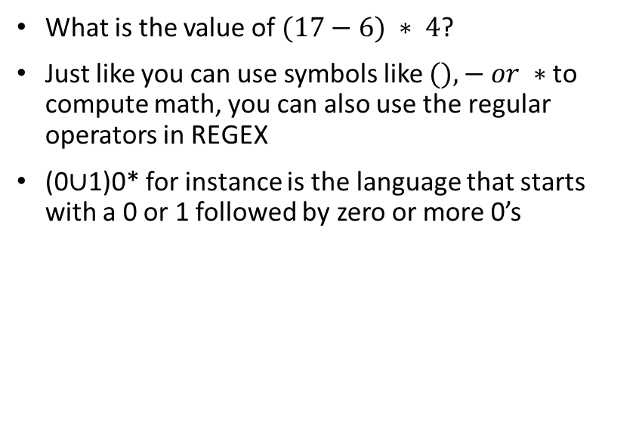
Let’s look at some symbols
What is the value of $(17−6) ∗ 4$?
Just like you can use symbols like $(),− or ∗$to compute math, you can also use the regular operators in REGEX
(0∪1)0* for instance is the language that starts with a 0 or 1 followed by zero or more 0’s

Slide 5

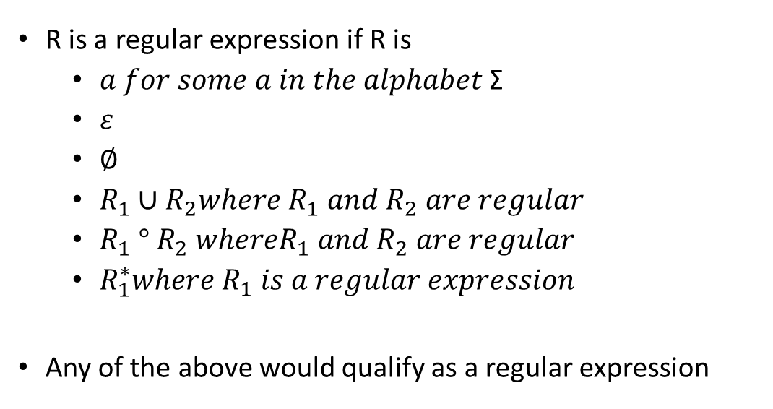
Formal definition of a regular expression
R is a regular expression if R is
$a for some a in the alphabet \text{Σ}$
$ε$
$\text{∅}$
$R_{1}∪R_{2}where R_{1} and R_{2} are regular$
$R_{1} ° R_{2} whereR_{1} and R_{2} are regular$
$R_{1}^{∗}where R_{1} is a regular expression$
Any of the above would qualify as a regular expression

Slide 6
All regular expressions are equivalent to finite automata
Yep, you heard it here!
Those super annoying and hard to write greedy character searchers are actually equivalent to those super nice DFA’s and NFA’s we’ve been studying so far!

Slide 7
Proof: a language is regular if and only if some regular expression describes it
We can prove this by converting a regular expression R into an NFA
Since an NFA is equivalent to a DFA then we can also show that the language R recognizes is regular
The actual proof is on page 67 of our book and we’ll do it on OneNote
Note the if and only if statement
This means we need to also prove that if a language is regular then it is described by a regular expression
We can prove this using generalized nondeterministic finite automata (GNFA)

Slide 8

Wait, GNFA?
These aren’t any weirder than epsilon-moves NFAs
The difference is that the transition arrows can have regular expressions literally on top of them
Also:
The start state has arrows going to every state but has no arrows coming in
There is only one accept state with arrows coming in from every other state but no arrows going out
Except for the start and accept state, one arrow goes from every state to every other state and to itself as well
With these partial regular expressions, we can simplify a NFA to a GNFA until we find the whole regular expression

Slide 9

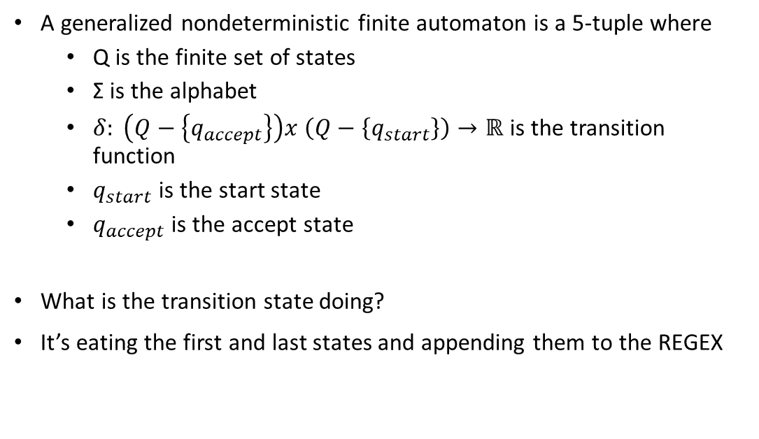
Defining a GNFA
A generalized nondeterministic finite automaton is a 5-tuple where
Q is the finite set of states
Σ is the alphabet
$δ: \left(Q−\left\{q_{accept}\right\}\right)x \left(Q−\left\{q_{start}\right\}\right)→\text{ℝ}$ is the transition function
$q_{start}$ is the start state
$q_{accept}$ is the accept state
What is the transition state doing?
It’s eating the first and last states and appending them to the REGEX

